Slide 1
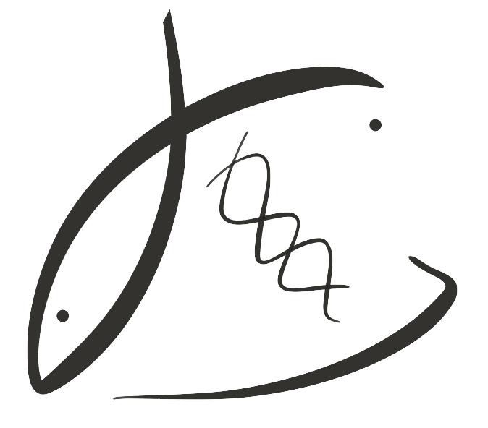





Effects of parental low pH exposure on gonadal and larval gene expression in the Olympia oyster
Laura H Spencer
Roberts Lab
School of Aquatic and Fishery Sciences
University of Washington
NSA Triennial, New Orleans 2019

Slide 2
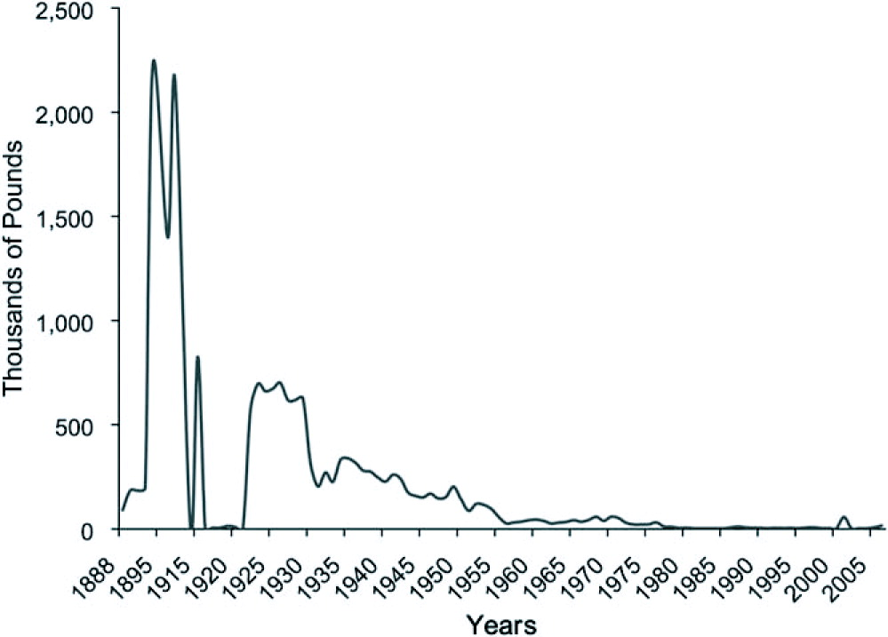
The Olympia oyster
Pacific Coast’s only native oyster, populations crashed early 1900’s
White, Ruesink & Trimble, 2009
Notes:
MAP: Augmented map of 2009 Olympia oyster survey that found some locations Olys are absent entirely or absent in the intertidal.

Slide 3
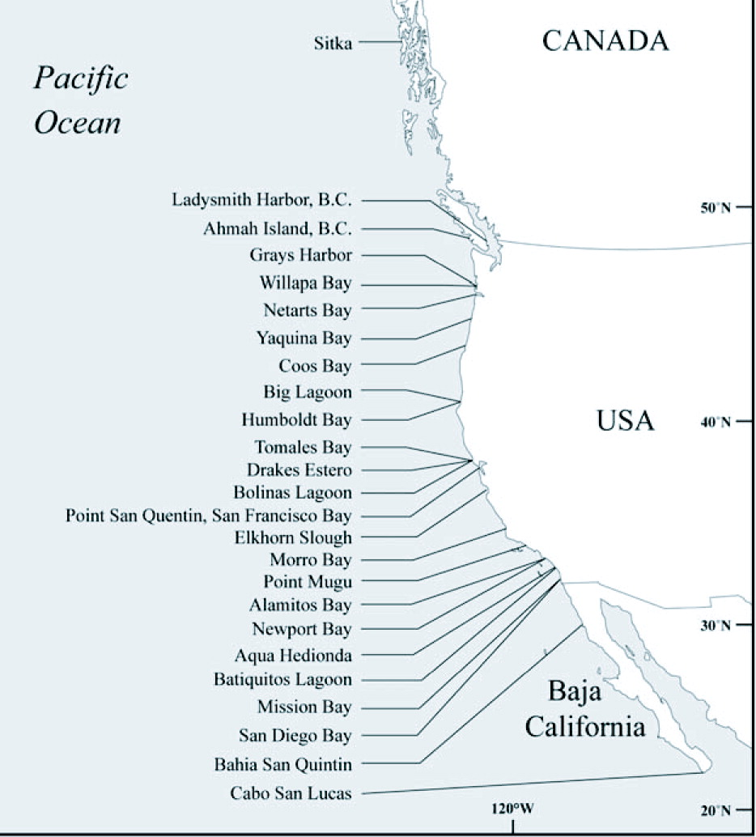
The Olympia oyster
All Absent
Intertidal Absent
Restoration occurring coast-wide to preserve and grow of remnant populations
Adapted from Polson & Zacherl, 2009
Notes:
MAP: Augmented map of 2009 Olympia oyster survey that found some locations Olys are absent entirely or absent in the intertidal.

Slide 4
The Olympia oyster
New threat: ocean acidification
Figure:
Depths of the undersaturated water (aragonite saturation < 1.0; pH < 7.75)
Feely et al. 2008
Notes:
MAP: Augmented map of 2009 Olympia oyster survey that found some locations Olys are absent entirely or absent in the intertidal.

Slide 5
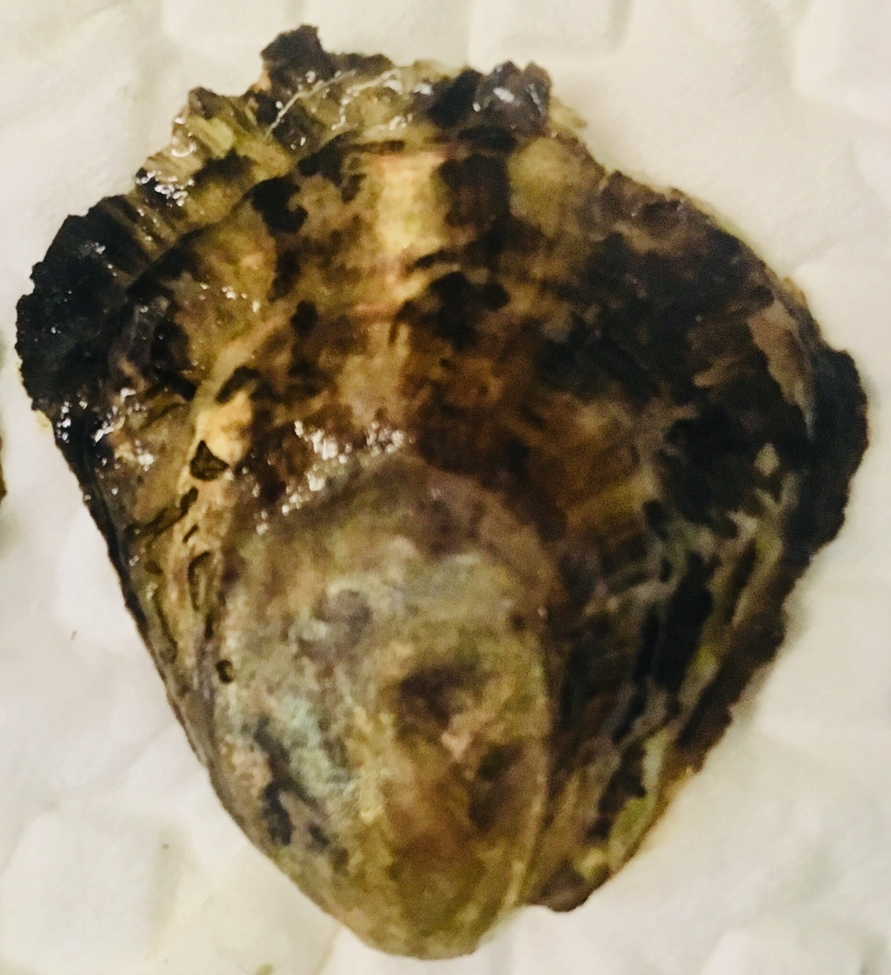
Ocean acidification, what we know
Early life stages are vulnerable
⬇ Larval growth, survival (Hettinger et al. 2013)
⬇ Juvenile growth after larval exposure (Hettinger et al. 2012)
⬆ Juvenile predation rate (Sanford et al. 2013)
Also evidence of tolerance (Waldbusser 2016)
Parental exposure?

Slide 6
Can oysters “adapt” to OA?
Parental exposure can influence offspring response to stress (e.g. Parker et al. 2012)
This may allow oyster populations to quickly respond to changing ocean
Notes:
Reason why we’re interested in exploring adult exposure is that there is an exciting and optimistic theory that a parent’s exposure to stress can make the next generation more resilient to that stress.
This may allow for oysters to respond more quickly to ocean acidification, rather than relying solely on classic adaptation through gene mutation and natural selection.
(Paper: putnam 2016? Jeremias 2018? Rondon 2017?

Slide 7
Parental exposure, other oysters
Negative carry-over:
⬇ larval survival, maternal Pacific oyster (Venkataraman in press)
⬇ fecundity, sex ratio change, Sydney rock oyster (Parker 2018)
Positive carry-over:
⬆ growth, Sydney rock oyster larvae (Parker 2012, 2015, 2017)
Olympia oyster? Mechanisms?
Notes:
Parker 2012:
Parents exposed during reproductive conditioning
Larvae from exposed parents larger, grew faster
Larvae exposed to low pH did OK if parent was exposed. BUT, if exposed to a secondary stressor, not OK

Slide 8
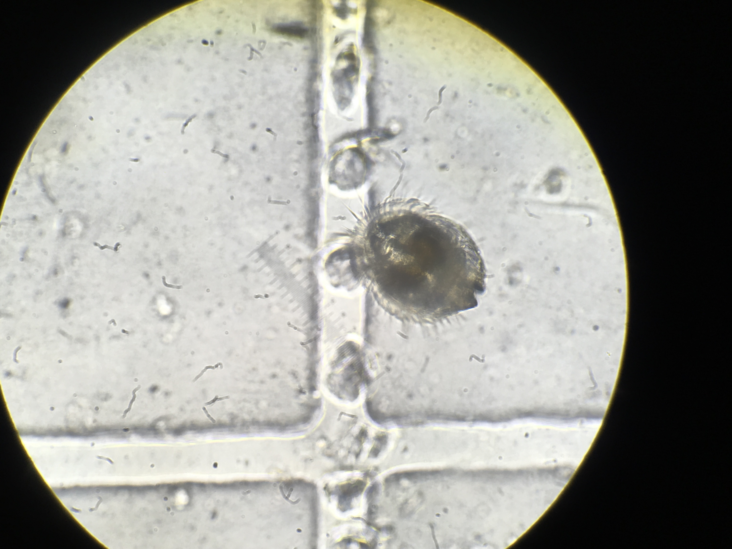
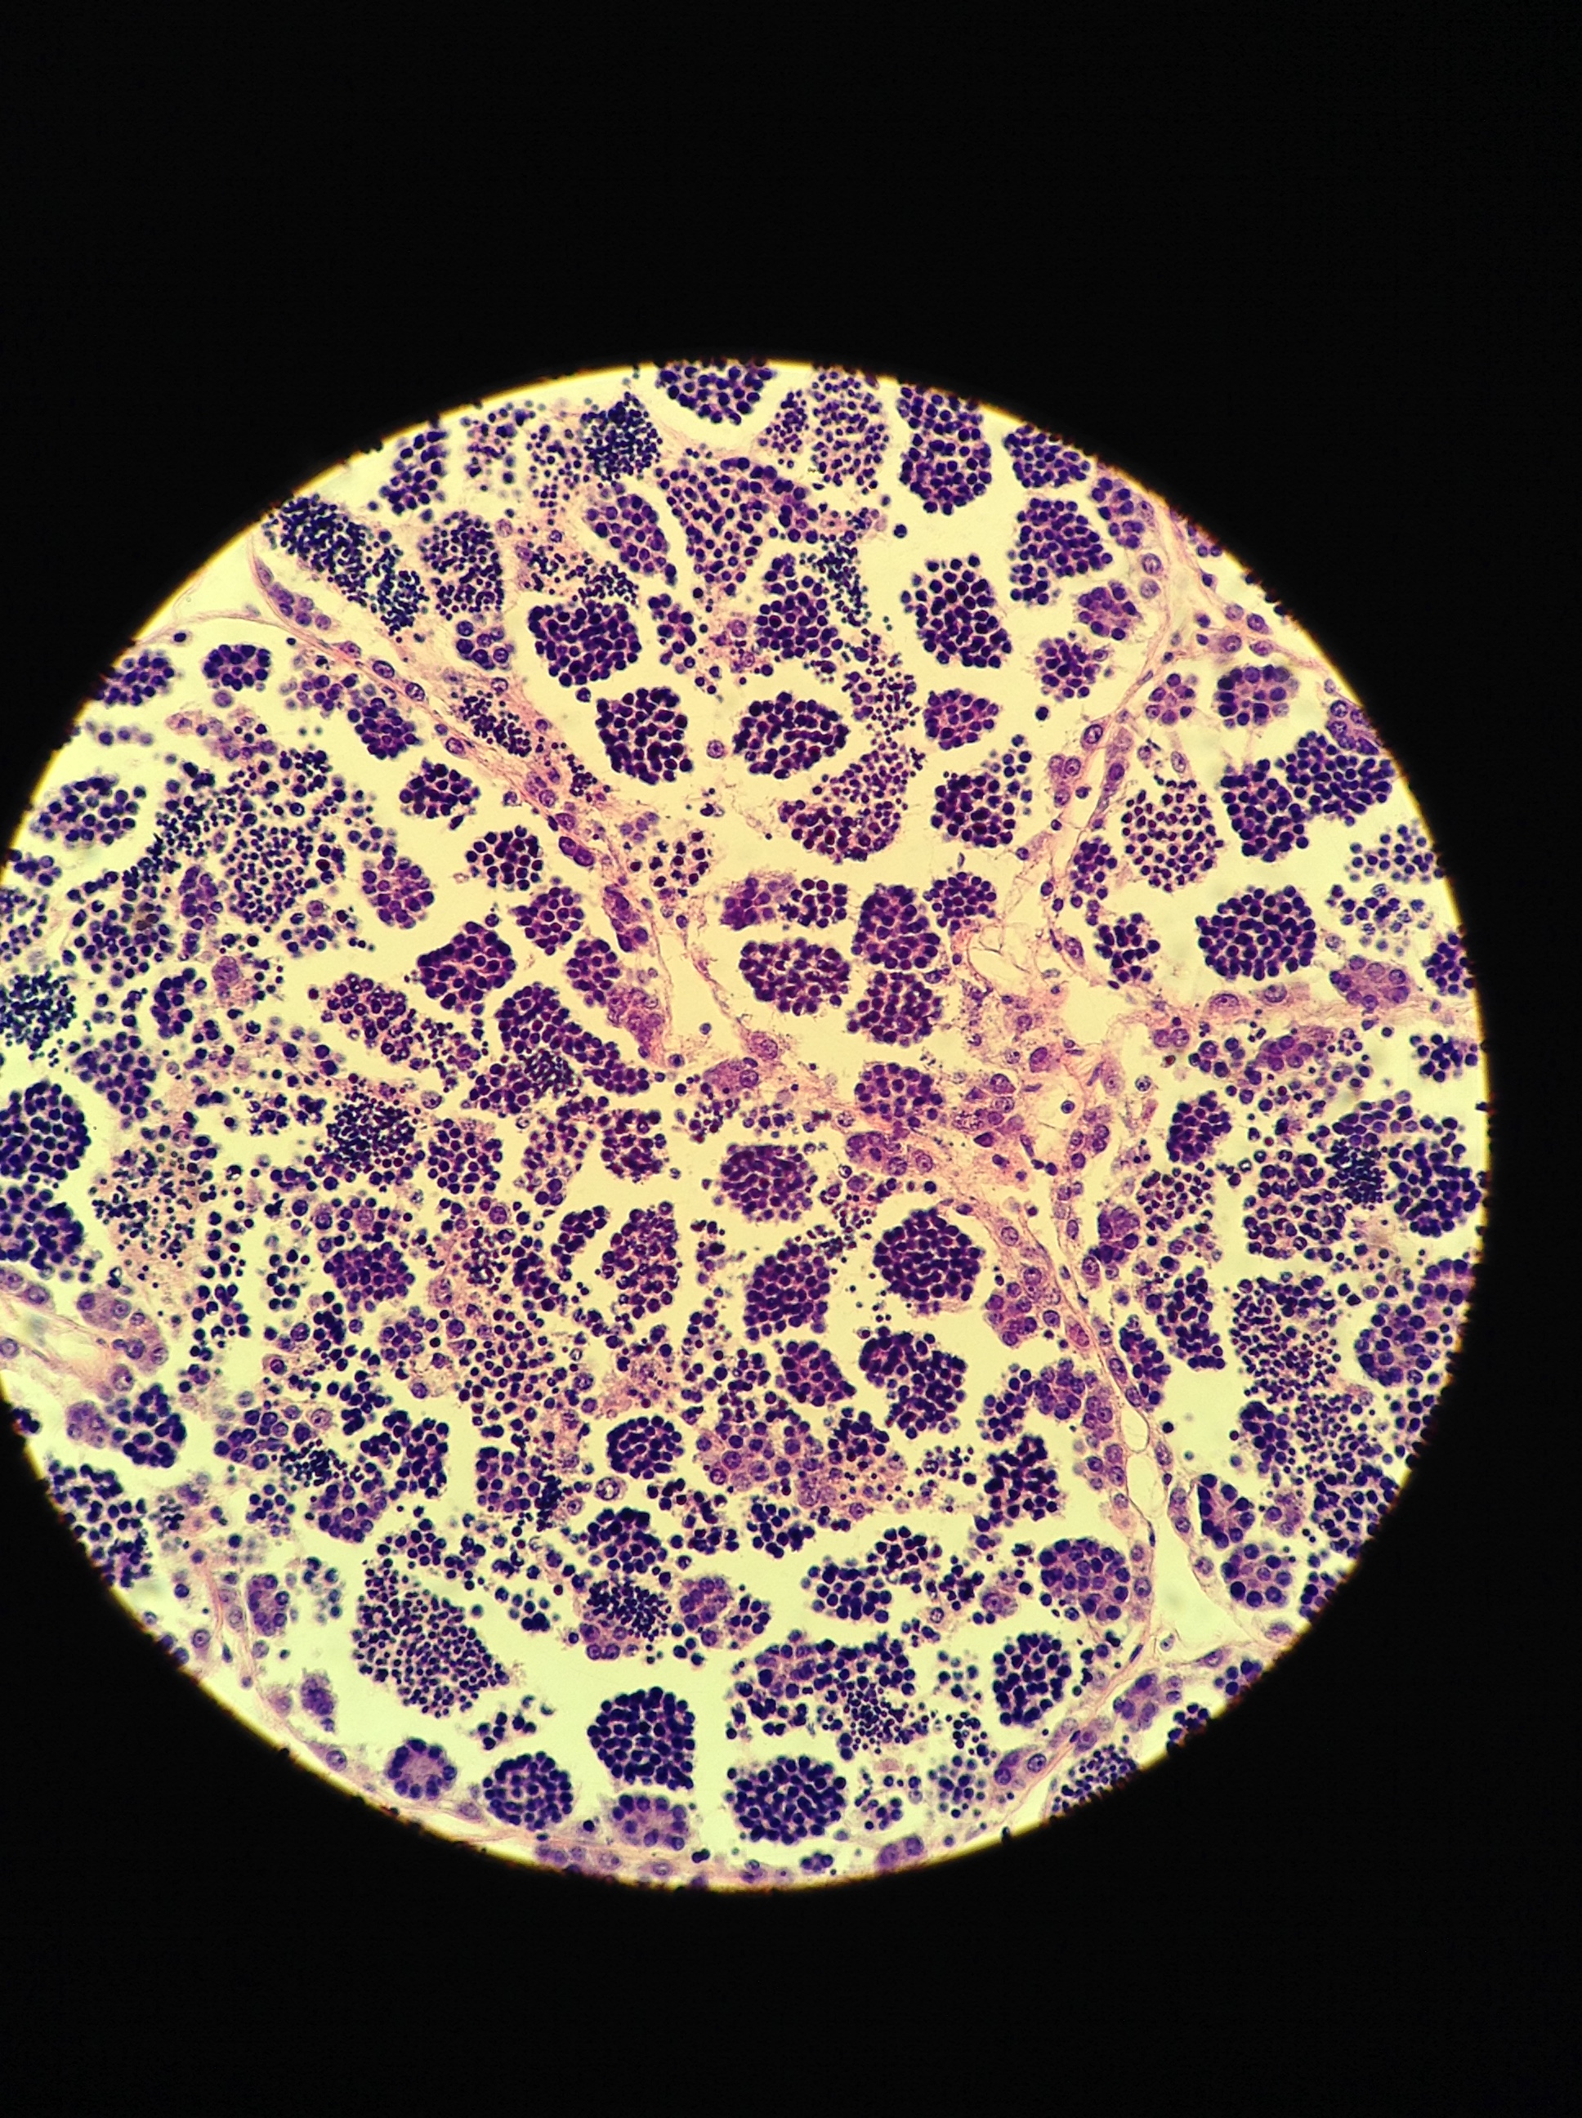
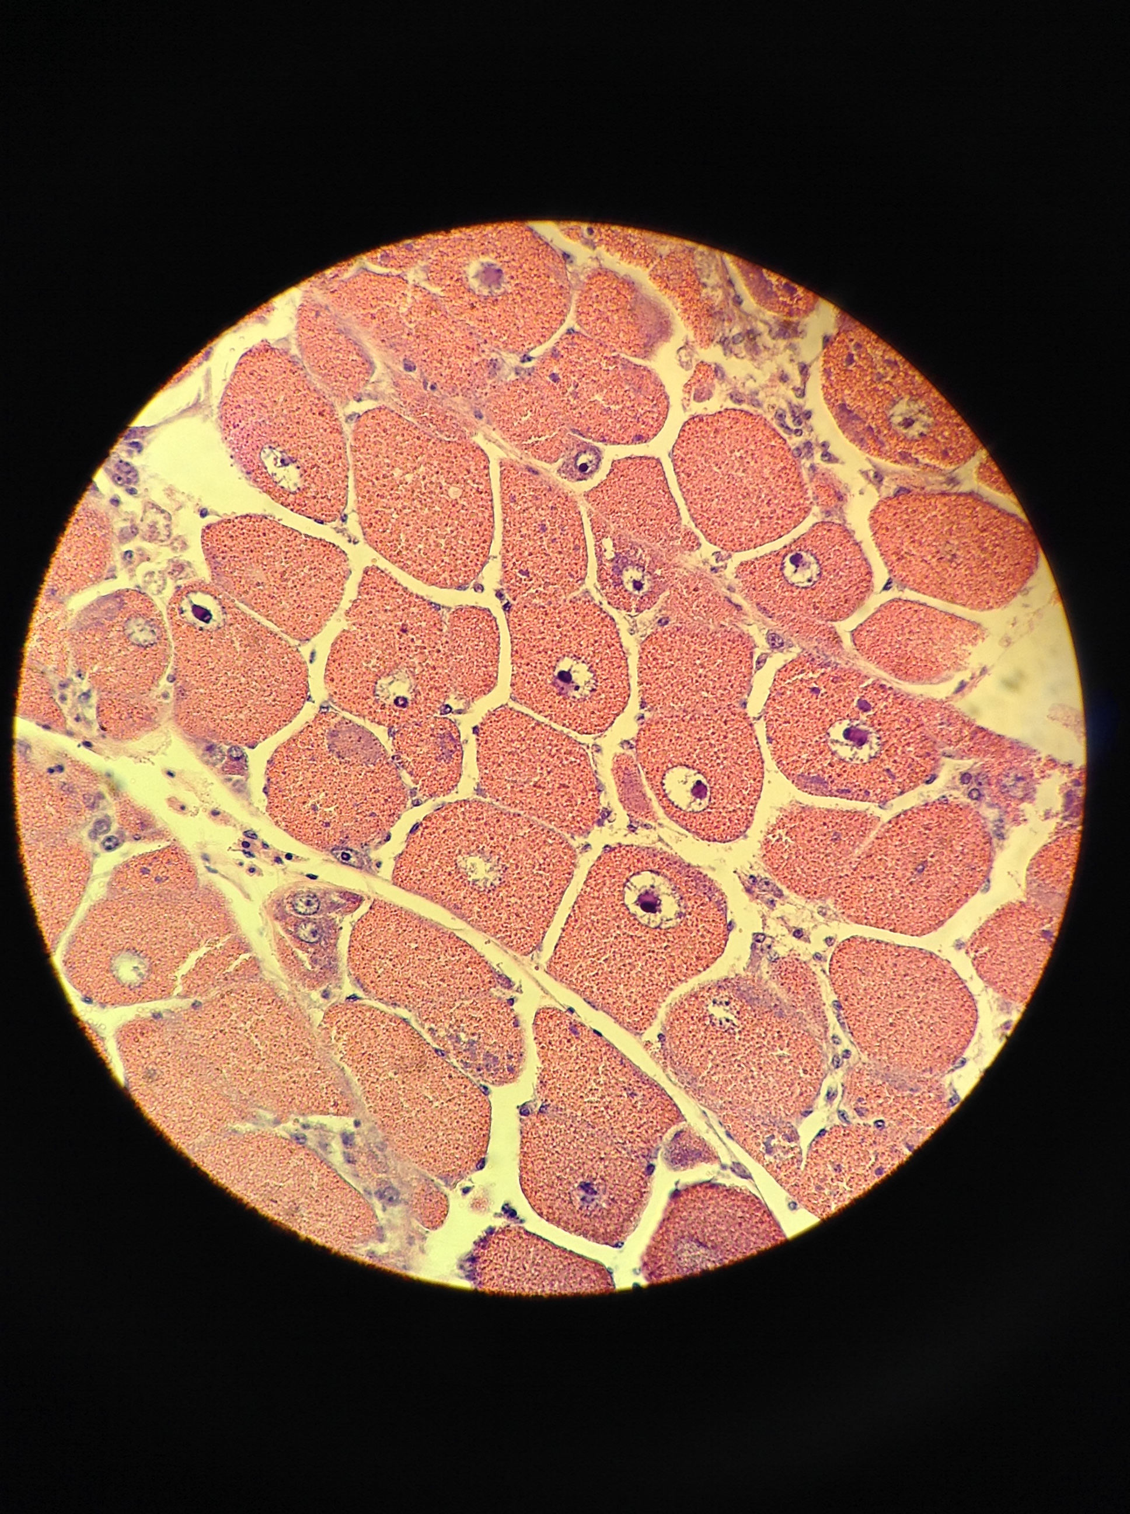
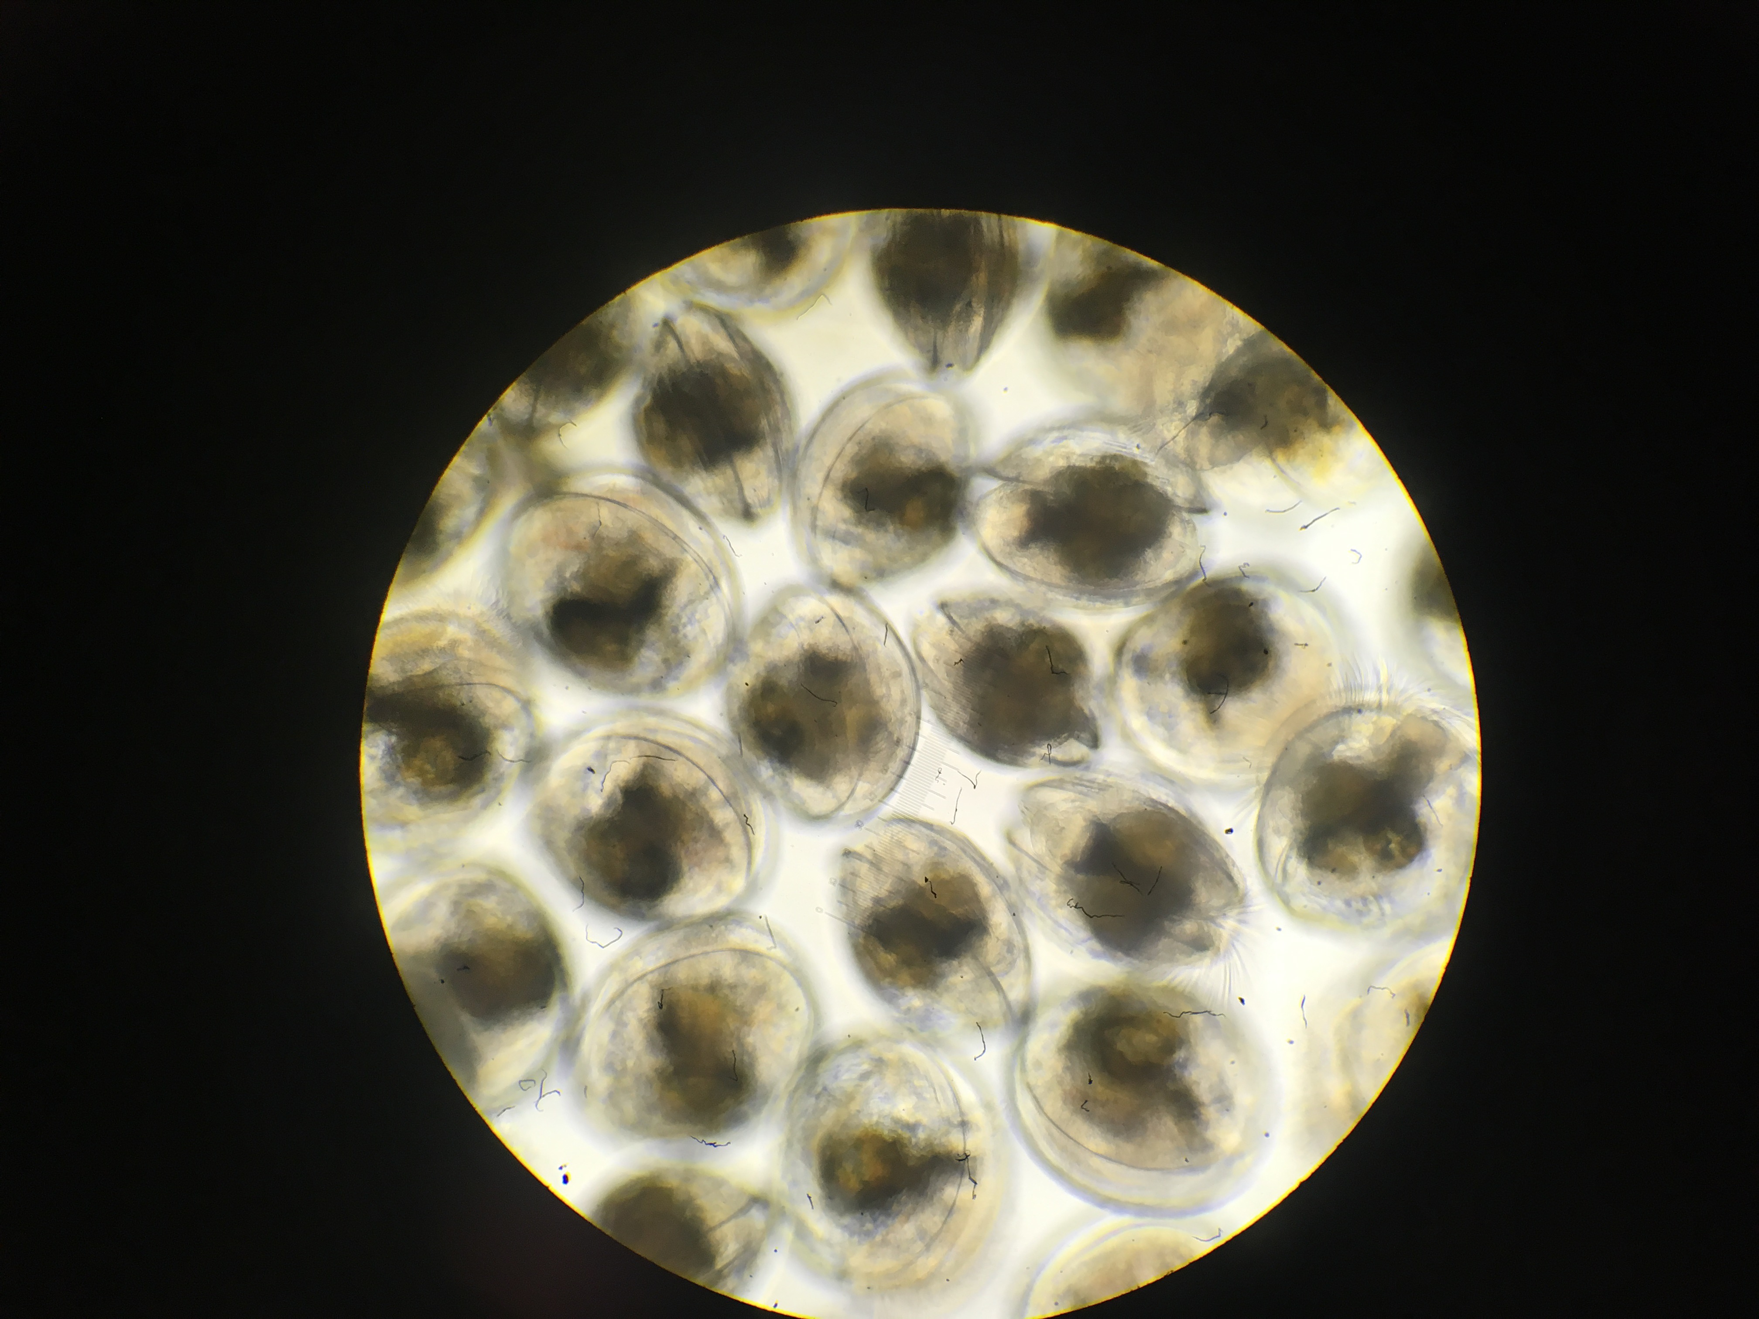
Questions
How does adult low pH exposure affect …
Adults:
Reproduction - gonad stage, # larvae produced
Physiology – gonad gene expression
Offspring
Viability – survival
Physiology – larval gene expression

Slide 9
Design
Time
Phase
pH
Metric
Adults in pH treatment
(7 weeks)
Low (7.3) Ambient (7.8)
Gonad stage, gonad expression
Adults induced to spawn
Ambient
pH
Timing of larval onset
Larvae collected
(7 weeks)
# larvae produced
Larvae reared
Larval gene expression
Survival
Notes:
2 adult cohorts

Slide 10
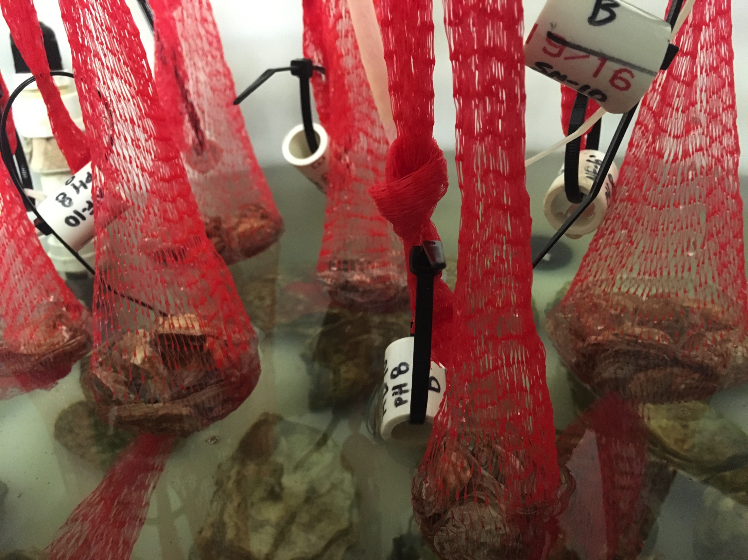
Adults held 7 weeks in low pH (7.3), ambient pH (7.8)
pH
Spawn & collect
Rear

Slide 11
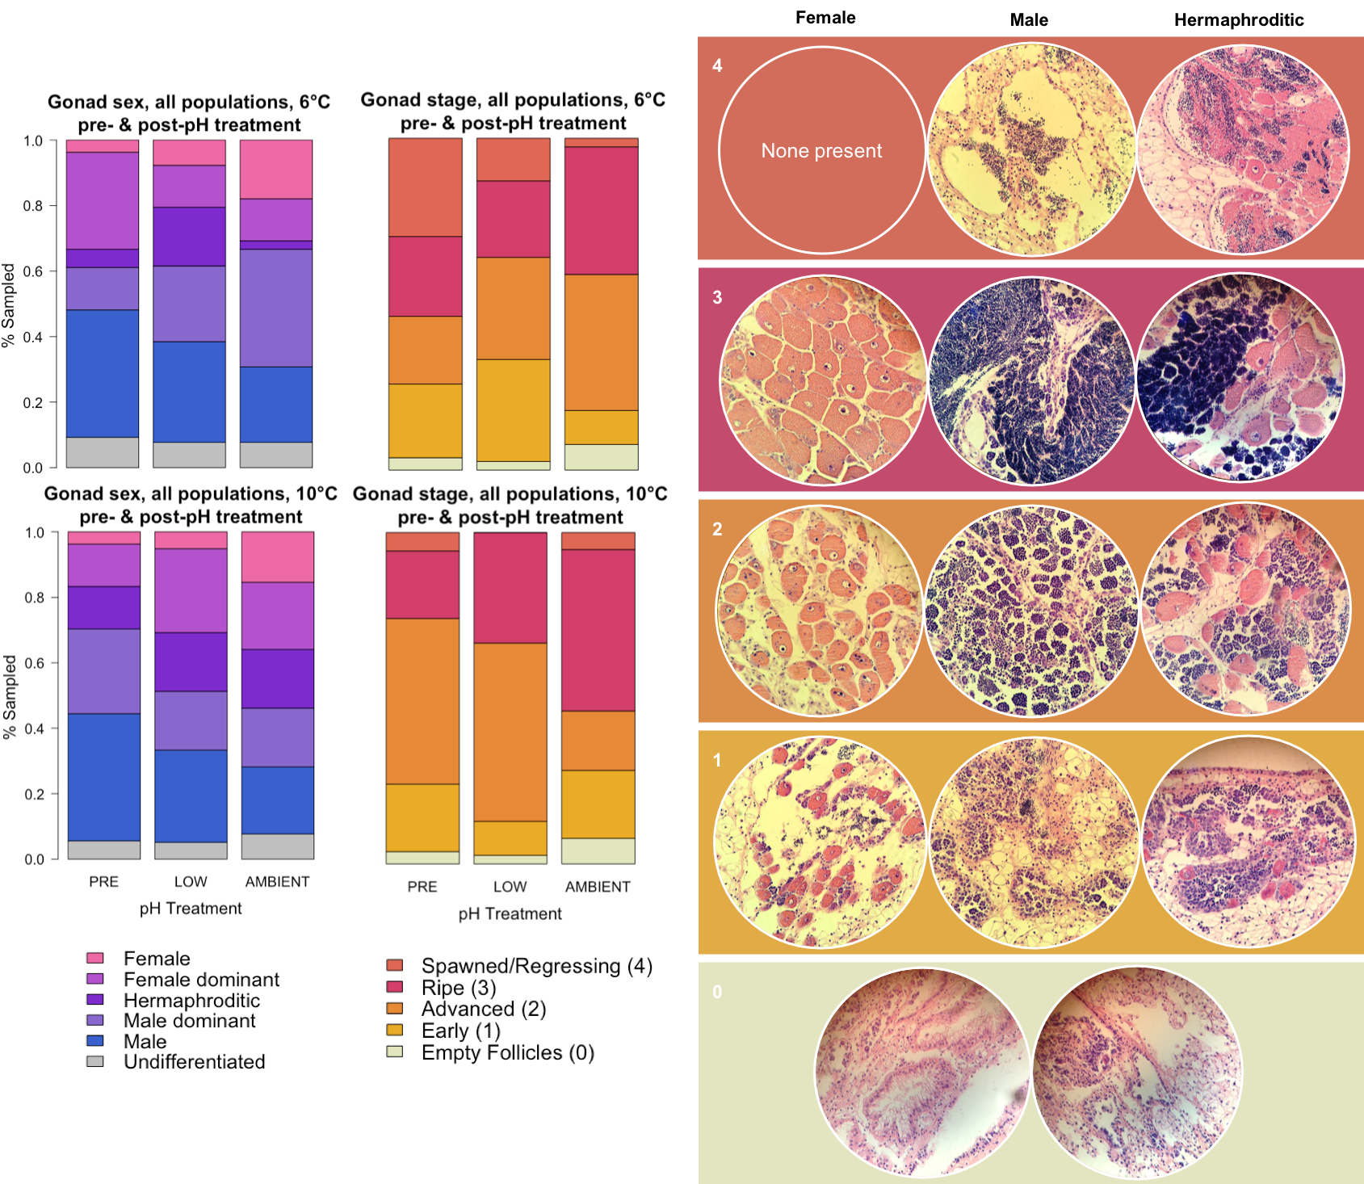
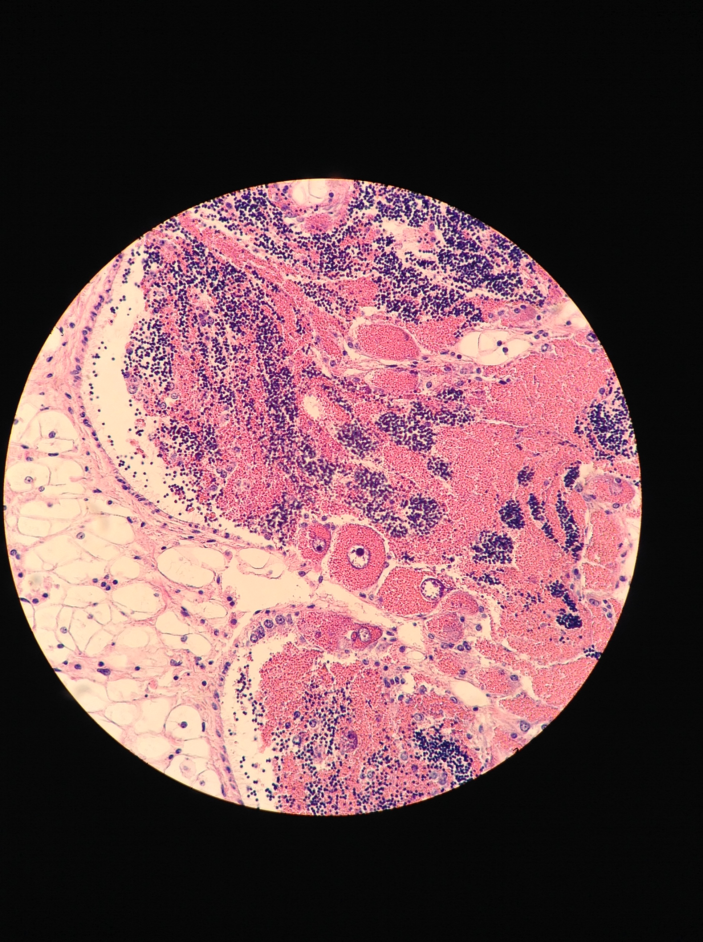
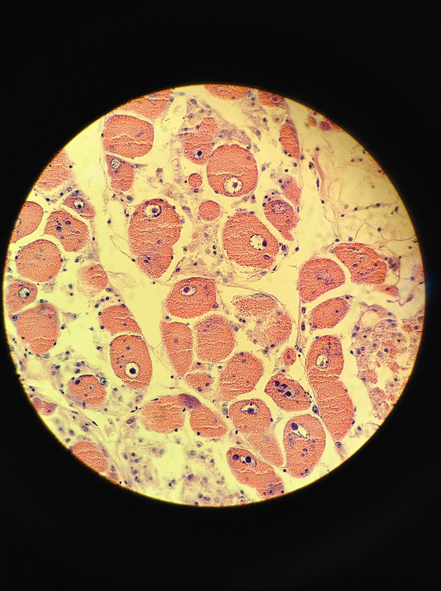
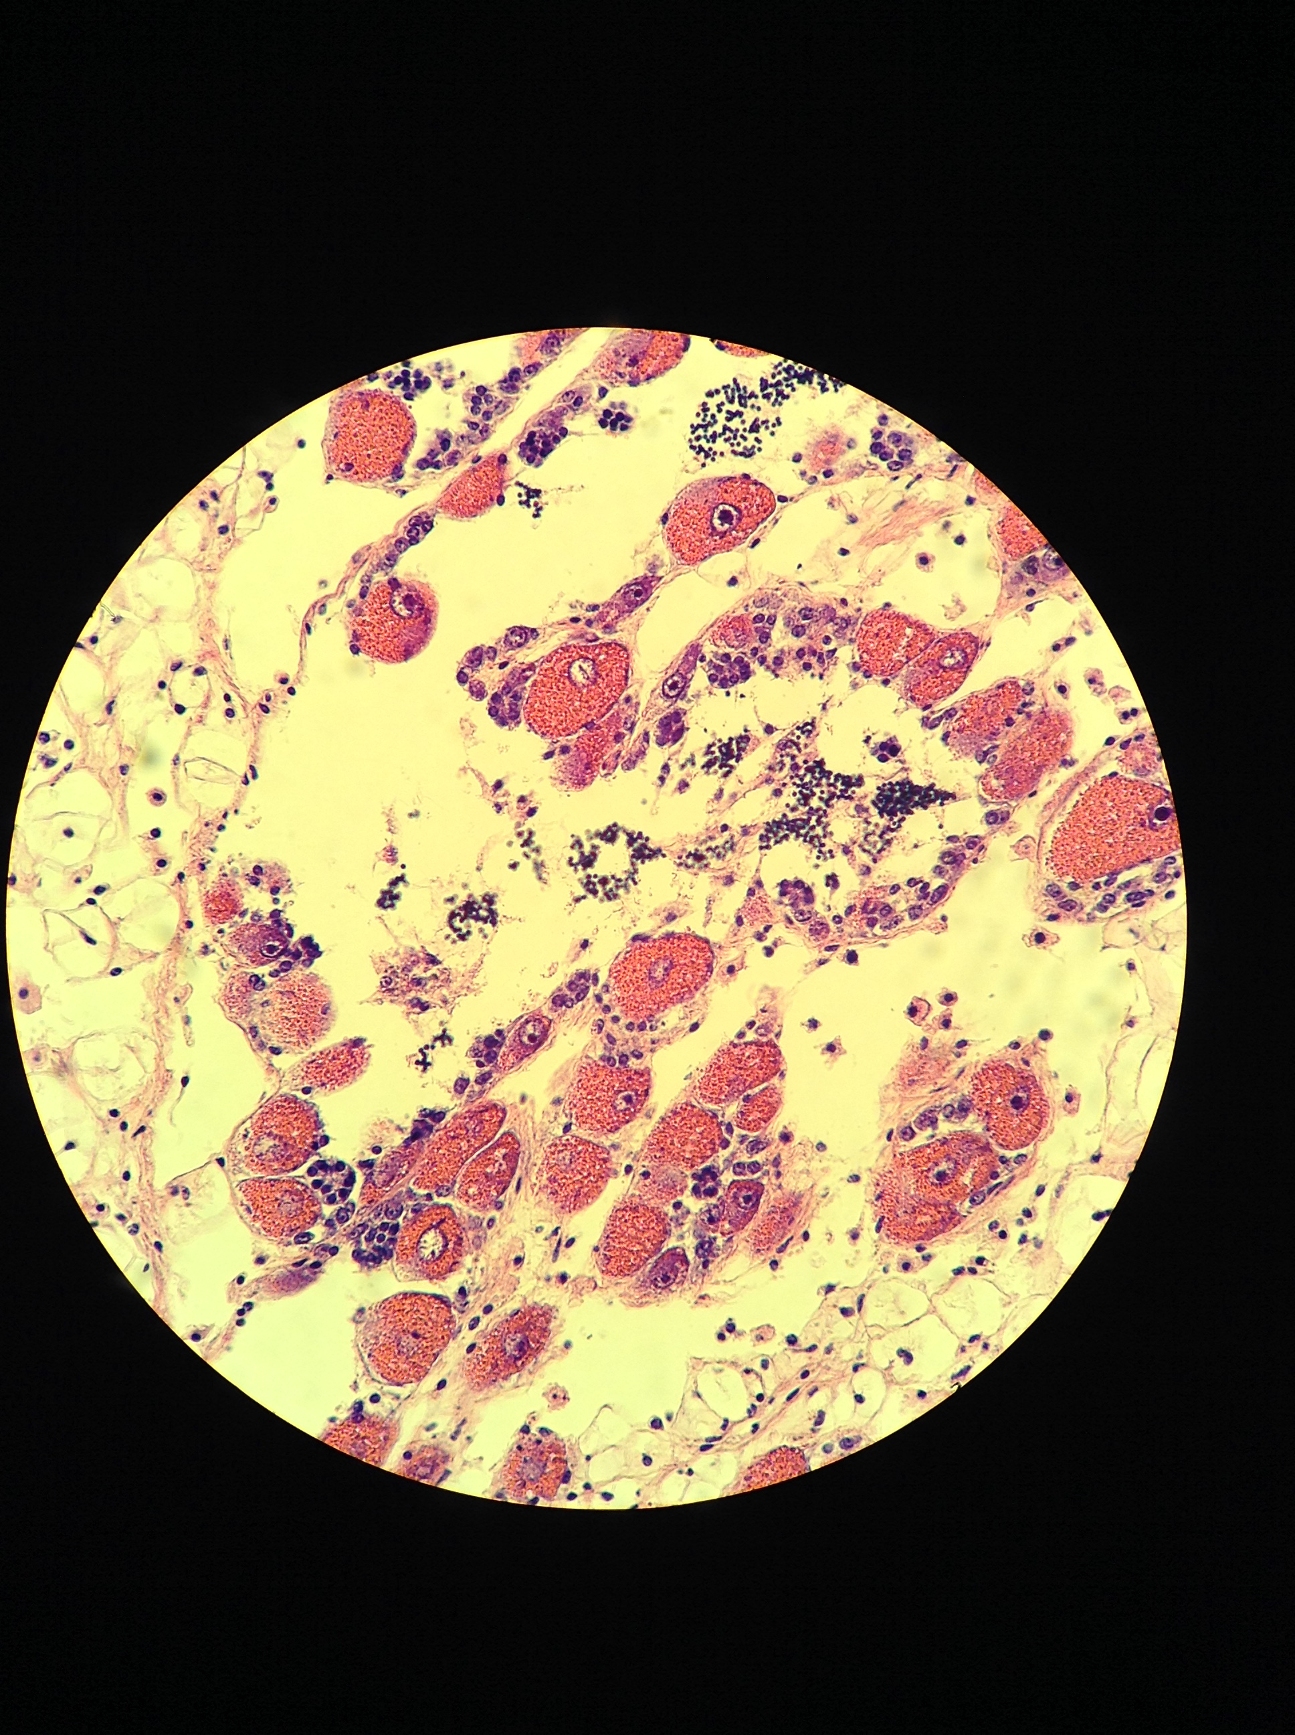
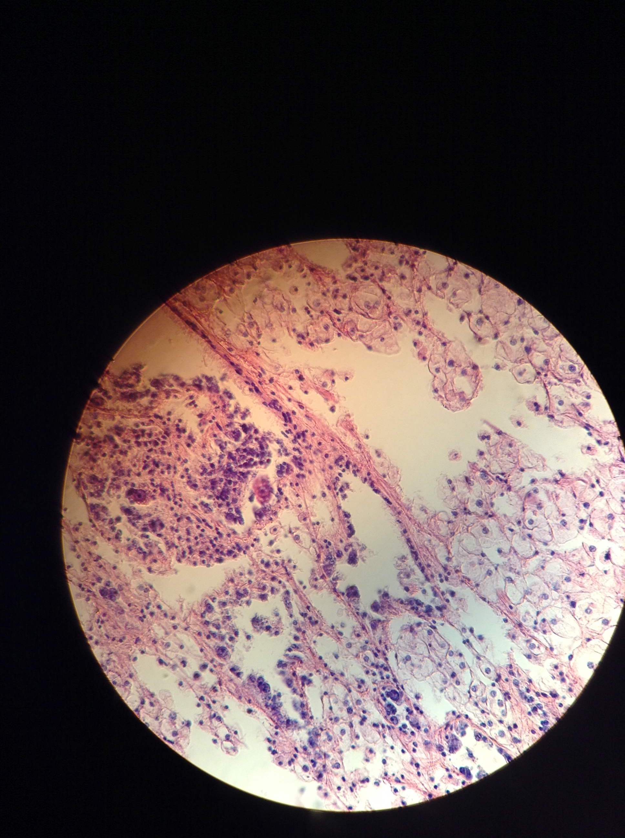
No pH effect on female gonad stage
STAGE 4
Partially spawned / resorbing
pH
STAGE 3
Ripe
3
STAGE 2
Advanced
Spawn & collect
2
1
STAGE 1
Early
Rear
0
STAGE 0
No female activity

Slide 12
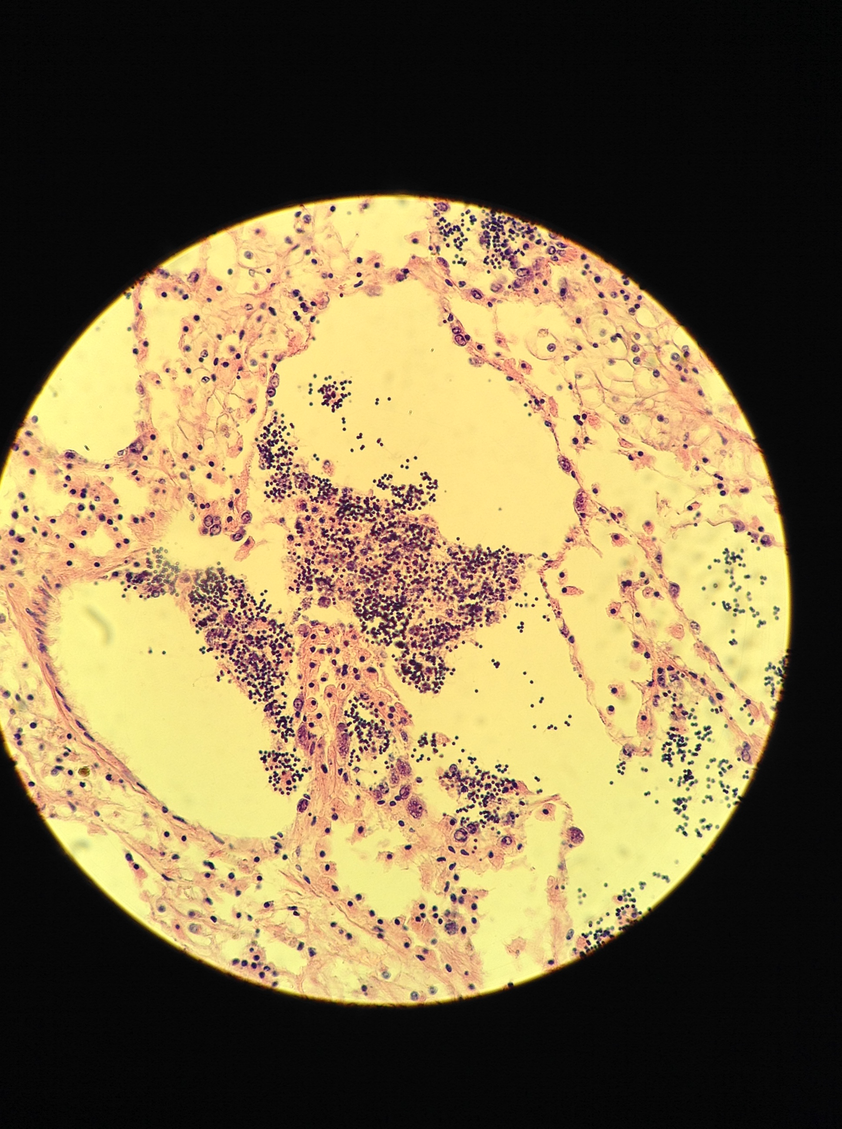
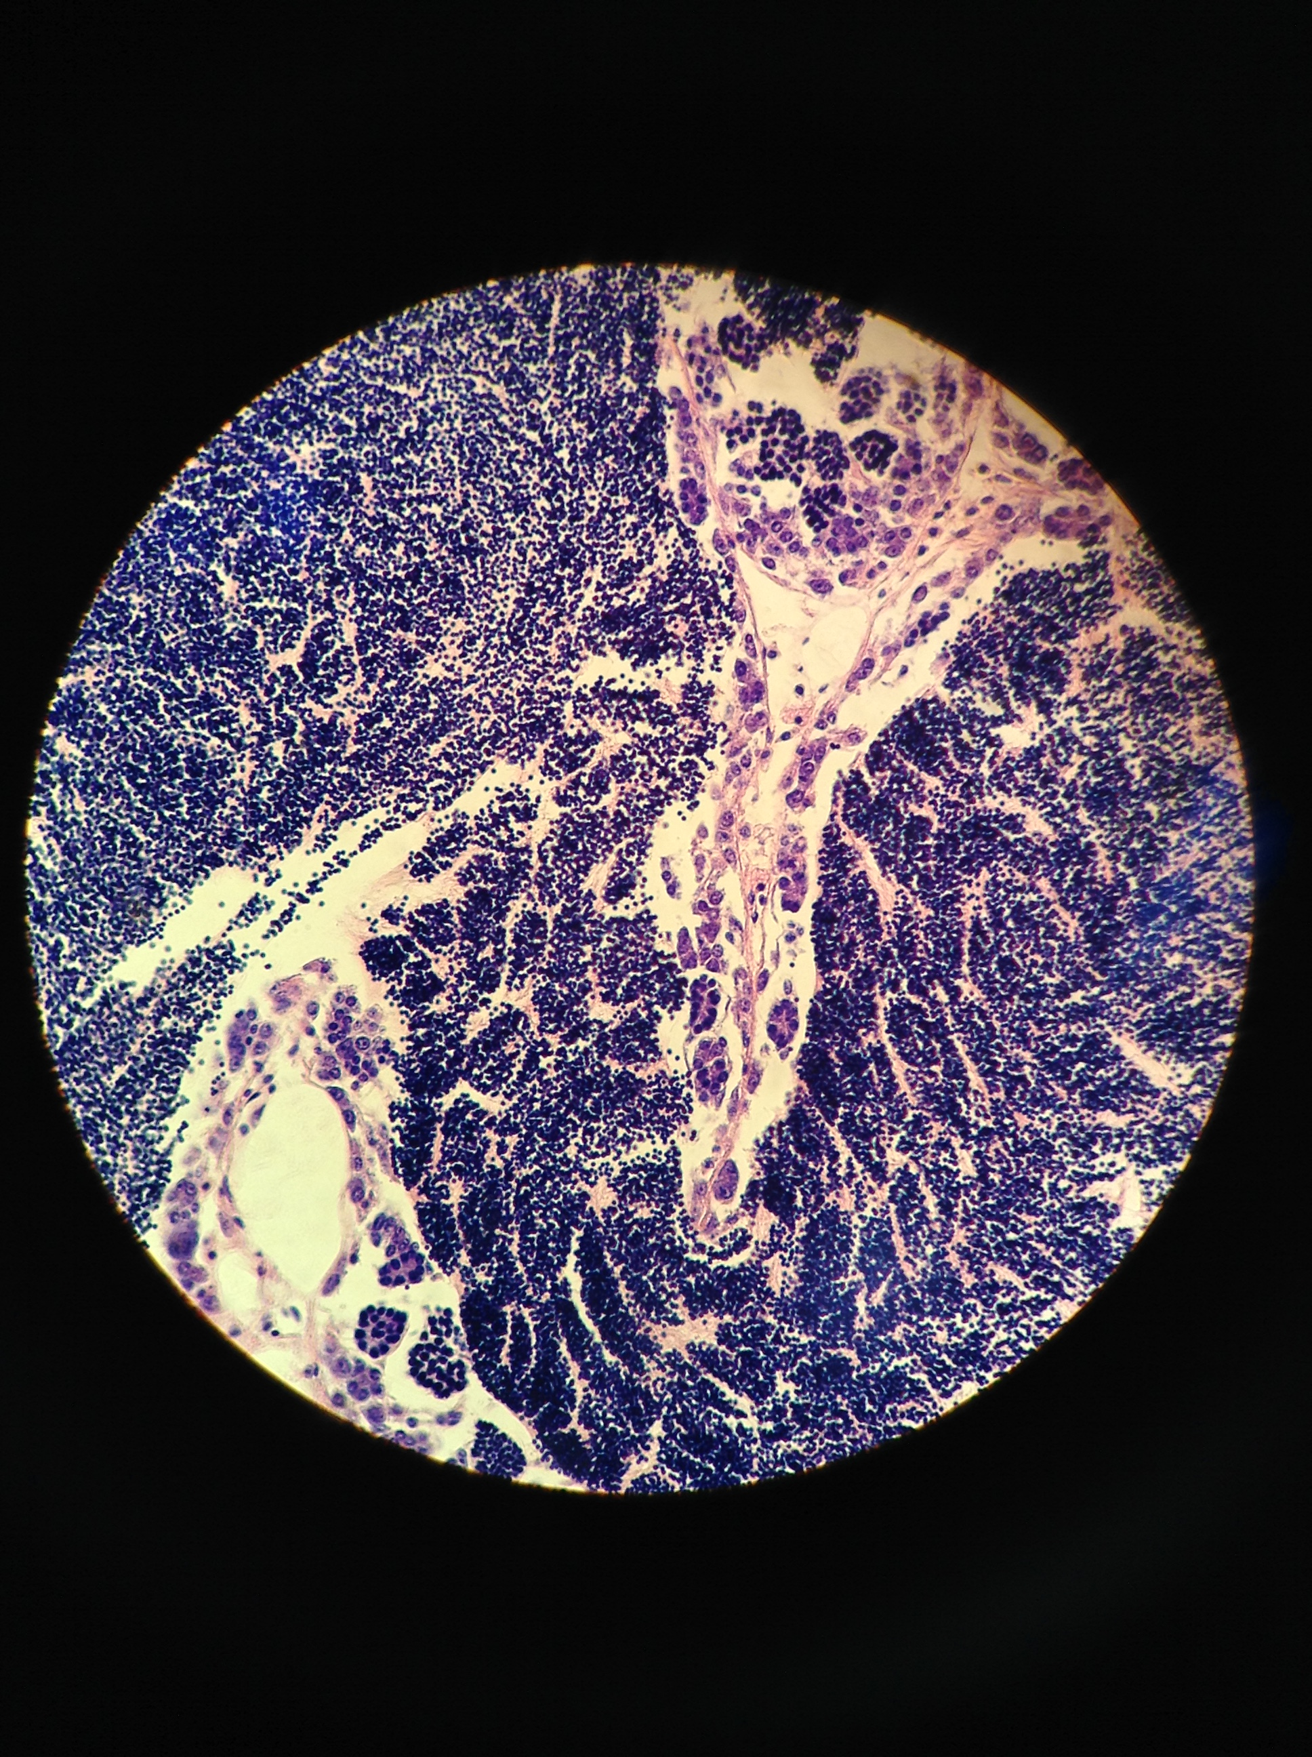
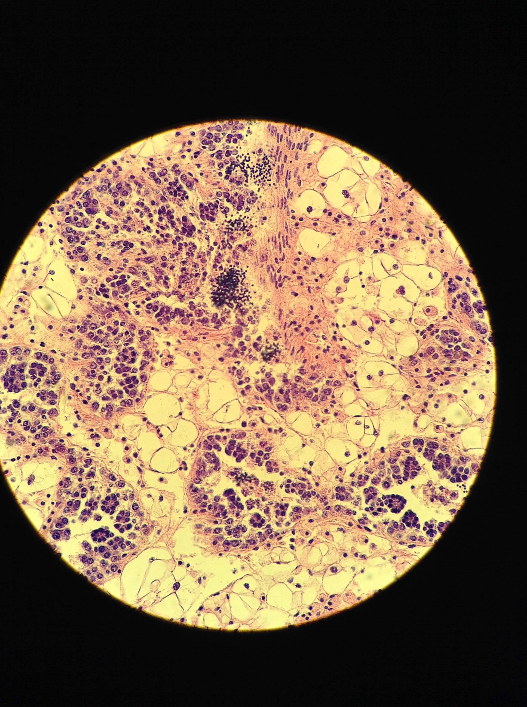
Fewer ripe males in low pH
STAGE 4
Partially spawned / resorbing
pH
STAGE 3
Ripe
4
STAGE 2
Advanced
Spawn & collect
3
2
1
STAGE 1
Early
Rear
0
STAGE 0
No male activity
p=0.011

Slide 13
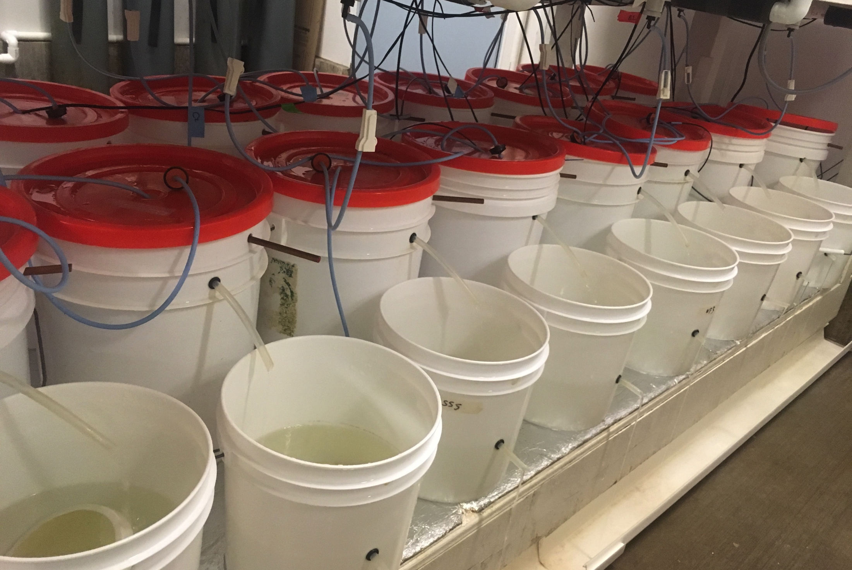
Larvae collected & counted for 7 weeks
pH
Spawn & collect
Spawn & collect
Rear

Slide 14
No pH effect on fecundity
pH
No Difference
No Difference
Spawn & collect
Spawn & collect
Rear
Notes:
- Hypothesis is that

Slide 15
No pH effect on fecundity Larval release delayed
pH
June 1
No Difference
May 17
No Difference
Spawn & collect
Spawn & collect
May 22
June 12
Rear

Slide 16
Adult gonad First look at differential expression
RNA sequenced using QuantSeq
Up-regulated in low pH:
Biosynthesis (DNA, protein)
Transcription regulation
Protein transport & stabilization (HSP70, stress response?)
Down-regulated in low pH
Aerobic respiration
Cellulose digestion
Defense response to bacteria, fungus
Intracellular signaling
Translation, phospholipid biosynthesis
pH
PCA Biplot, normalized gene counts
Spawn & collect
Rear
Notes:
UP
Thymidylate synthase Nucleotide biosynthesis
H/ACA ribonucleoprotein complex subunit DKC1 Ribosome biogenesis, rRNA processing
Elongation factor 1-delta protein biosynthesis
C-terminal-binding protein Transcription regulation
HSP70 protein stabilization
DOWN:
Defense response:
Macrophage-expressed gene 1 protein host defense against bacteria
Hemagglutinin/amebocyte aggregation factor aggregation of amebocytes and agglutination of erythrocytes
Coactosin-like protein defense response to fungus
Biosynthesis / cell regulation:
Haloacid dehalogenase-like hydrolase domain-containing 5 glycerophospholipid biosynthetic process
Protein quaking-B cell differentiation, mRNA processing, regulation of translation, RNA splicing
Endoglucanase cellulose cellulose catabolic process
Rho guanine nucleotide exchange factor 3 intracellular signal transduction
S-crystallin SL11 S-crystallins are structural components of squids and octopi eye lens. Contains relatively little if any GST activity

Slide 17
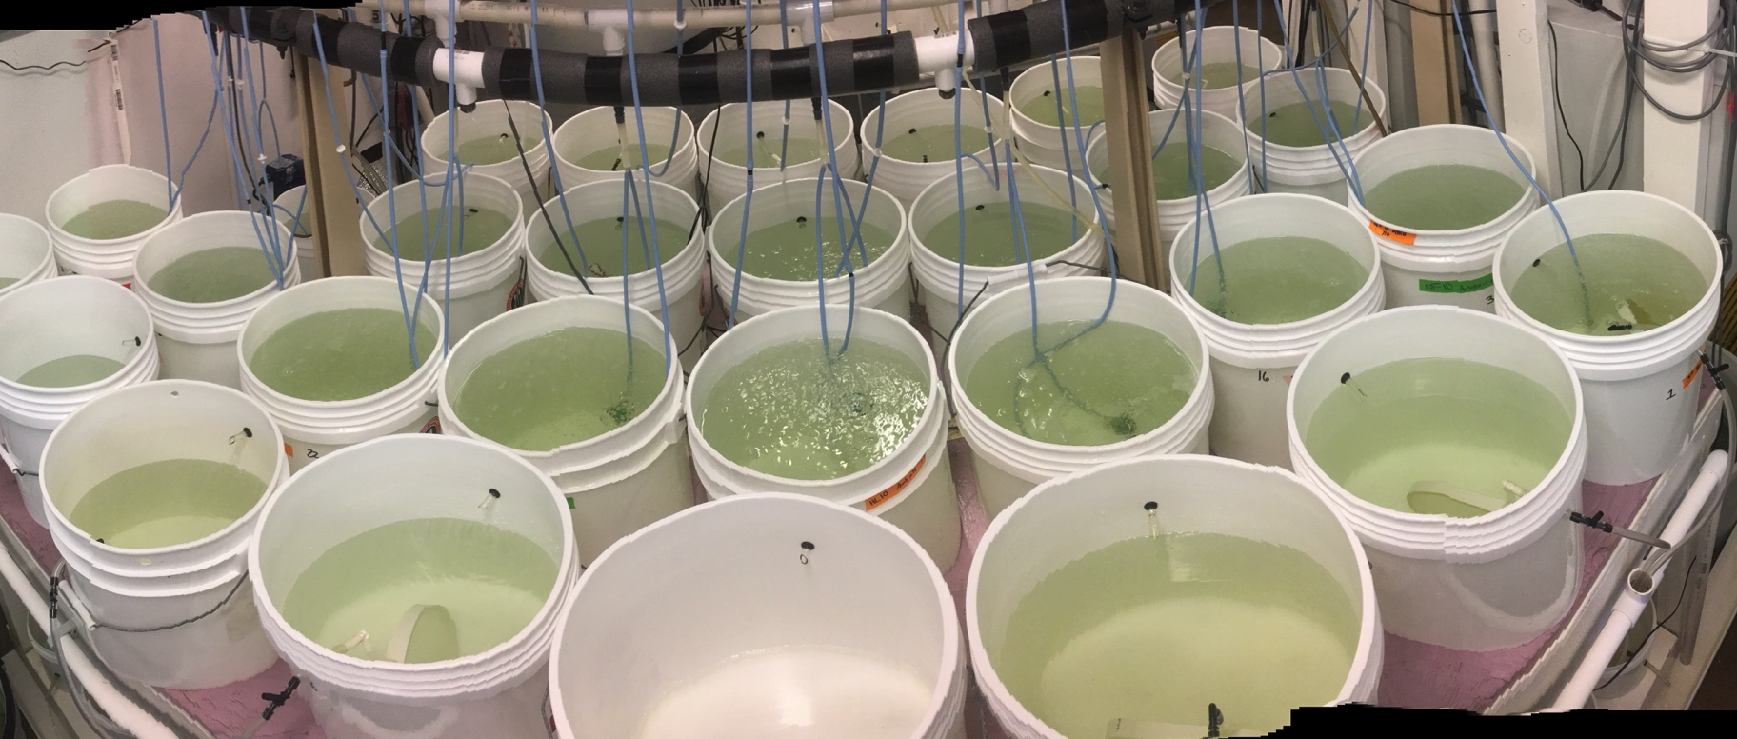
Larvae collected Subset reared, sequenced
pH
Spawn & collect
Rear
Rear

Slide 18
Survival trended lower from low pH parents (not significant)
pH
p=0.067
Spawn & collect
Rear
Rear

Slide 19
Newly released larvae
First look at gene expression
pH
RNA sequenced using QuantSeq
Up-regulated, low pH parents:
Cytoskeleton (Tubulin)
Cytoplasmic translation
Down-regulated, low pH parents
Aerobic respiration (COI)
Mitochondrial electron transport (mt:ND5)
DNA repair (ubiquitin component)
Protein transport, GTPase activity
PCA Biplot, normalized gene counts
Spawn & collect
Rear
Rear
COI: Cytochrome c oxidase, aerobic respiration
mt:ND5: NADH-ubiquinone oxidoreductase, mitochondrial electron transport
USP47: Ubiquitin component, DNA repair
TBC1D2: protein transport, GTPase activity
Tuba3a: Tubulin, cytoskeleton
Rpl8: ribosomal protein, cytoplasmic translation

Slide 20
Conclusions: Adults exposed to low pH
Adults
Delayed spermatogenesis & reproduction
⬇ Aerobic metabolism (COI)
⬆ Protein repair (HSP70)
No effect on sex ratios, fecundity
Offspring
Larval survival trended lower (not significant)
⬇ Aerobic metabolism, translation, protein transport (COI, mtND5, TBC1D2)
⬆ Cytoskeleton (Tubulin), DNA repair (rpl8)
Notes:
NOT NEGATIVE EFFECT SURVIVAL despite smaller size @ deployment

Slide 21
Who cares?
If parental pH exposure alters larval physiology …
Future generations more capable of surviving in low pH world?
Notes:
NOT NEGATIVE EFFECT SURVIVAL despite smaller size @ deployment

Slide 22
Next steps
Explore offspring low pH response …
Different response to acute low pH shock if parent was exposed? (qPCR)
Why does expression differ?…
Epigenomes

Slide 23
thank you
Puget Sound Restoration Fund: Ryan, Stuart, Alice, Erin, Jade, Morgan, Brian, Betsy …
On-the-ground: Yaamini, Grace, Olivia, Megan, Rhonda, Kaitlyn, Lindsay, Duncan, Sam, Hollie, Steven, Steven’s kids, Brent, Mom & Ian
Committee: Steven, Rick, Jackie

Slide 24
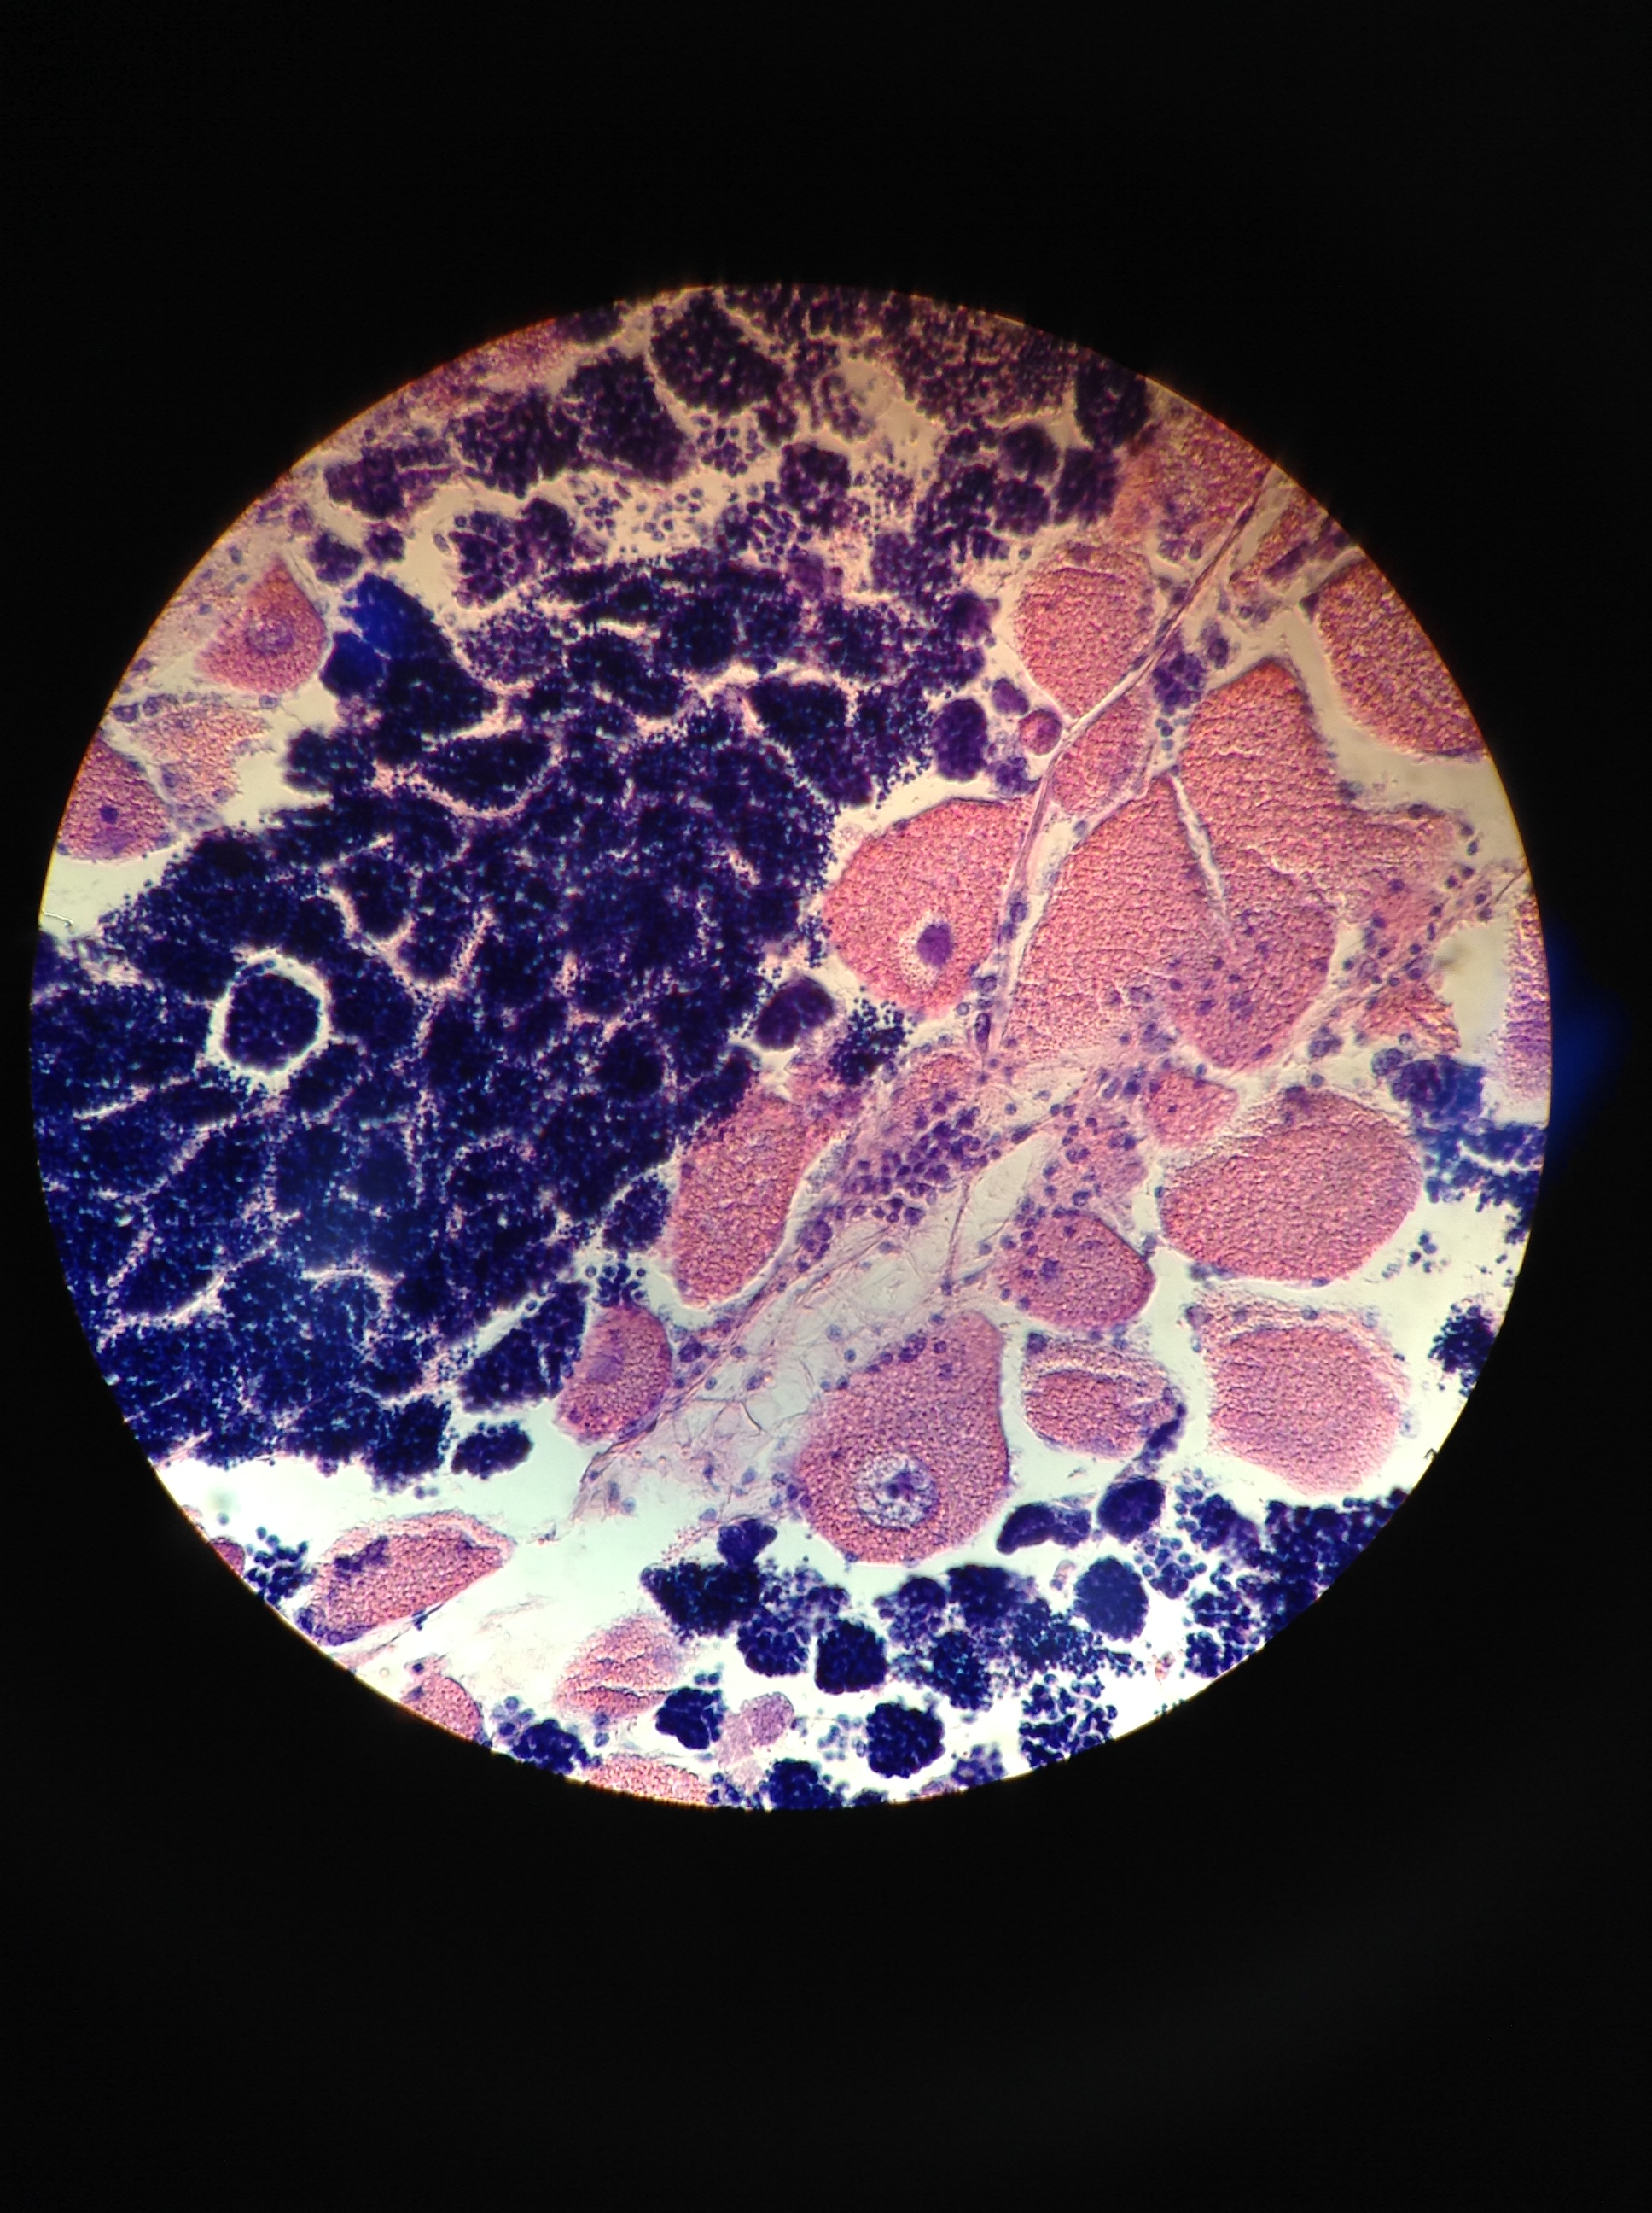
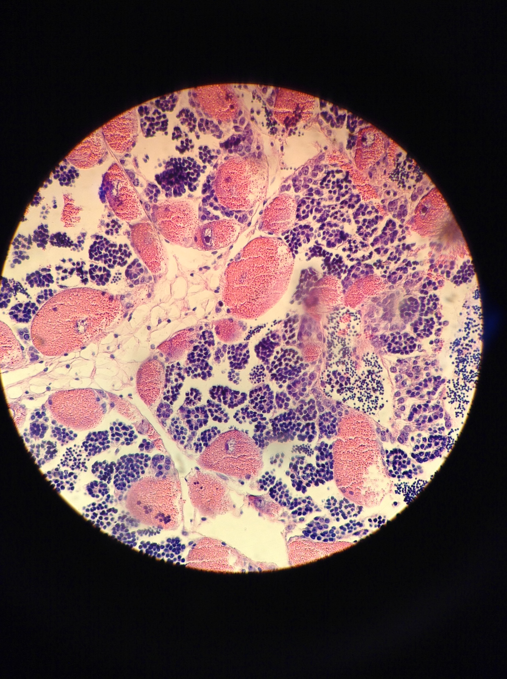
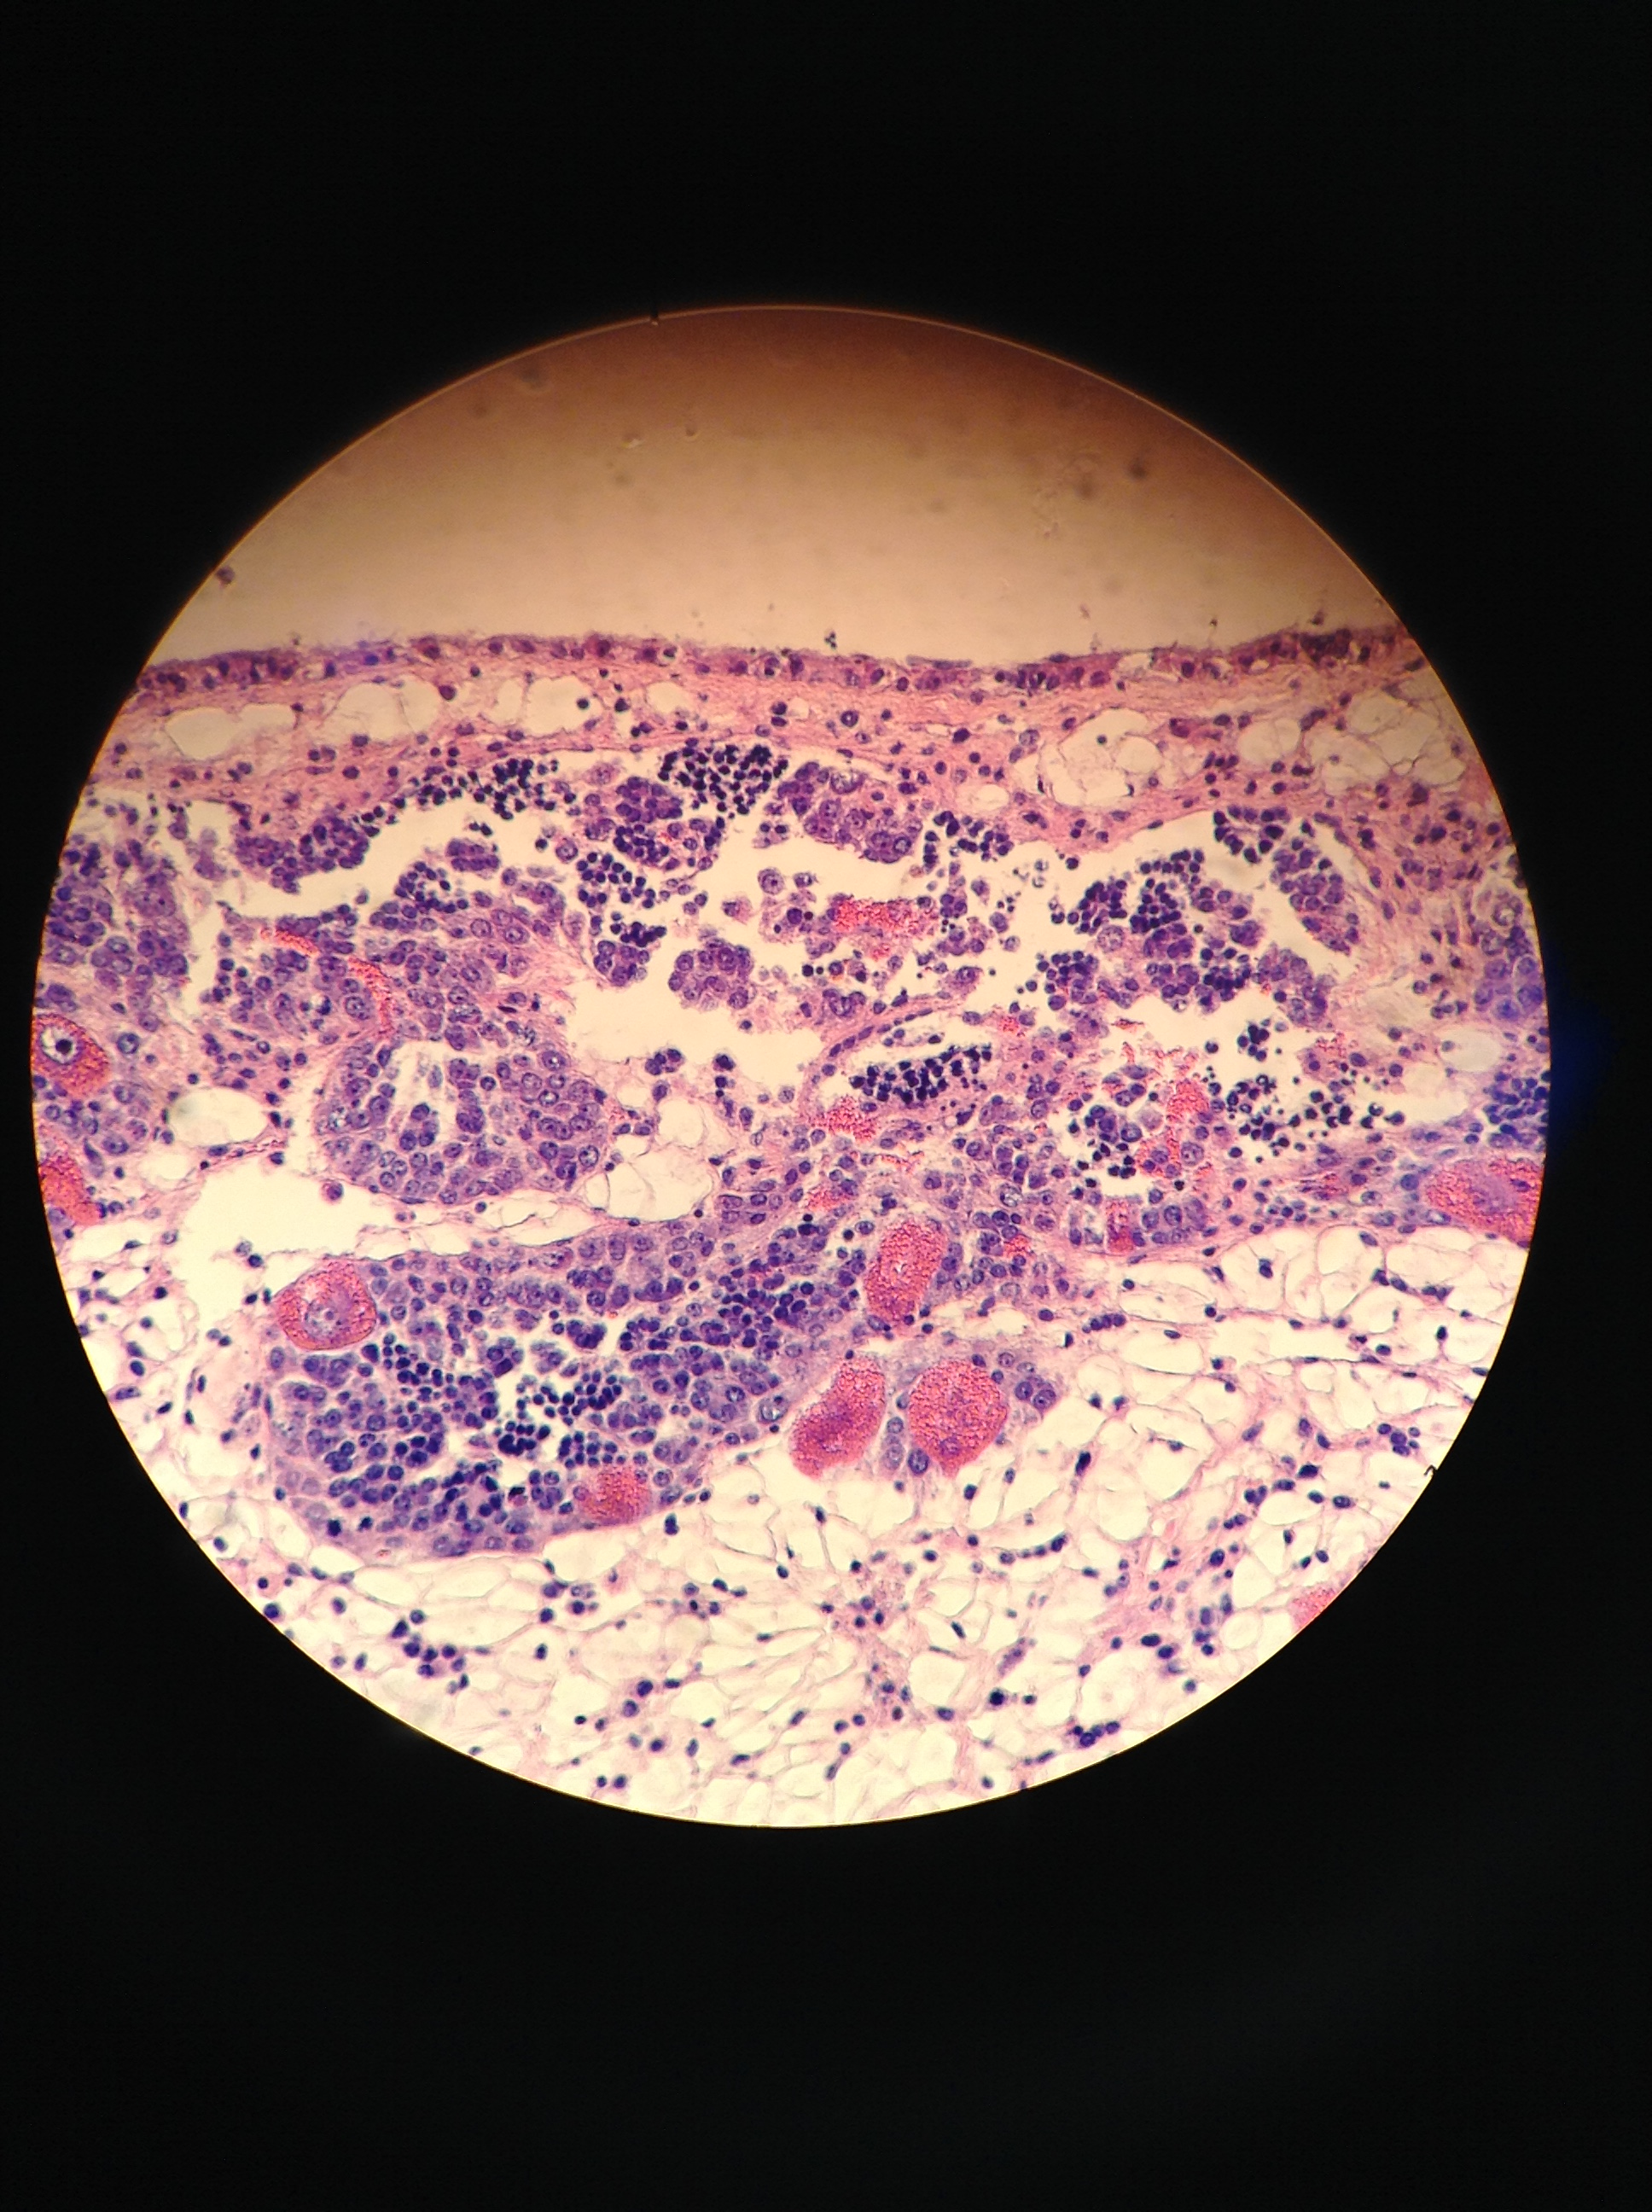
Olympia oyster gonad stage and sex
FEMALE
MALE
HERMAPH.
STAGE 4
SPAWNED/
RESORBING
None present
STAGE 3
RIPE
STAGE 2
ADVANCED
STAGE 1
EARLY
STAGE 0
NO ACTIVITY

Slide 25
Larval gene expression First look at differential expression
COI: Cytochrome c oxidase, aerobic respiration
mt:ND5: NADH-ubiquinone oxidoreductase, mitochondrial electron transport
USP47: Ubiquitin component, DNA repair
TBC1D2: protein transport, GTPase activity
Tuba3a: Tubulin, cytoskeleton
Rpl8: ribosomal protein, cytoplasmic translation

Slide 26
Gonad gene expression First look at differential expression
pH
Spawn & collect
Rear
Heat Shock Protein: stress response, protein chaperone / repair

Slide 27
Gonad gene expression First look at differential expression
pH
Spawn & collect
Rear
Cytochrome c oxidase: aerobic respiration

